Slide 1
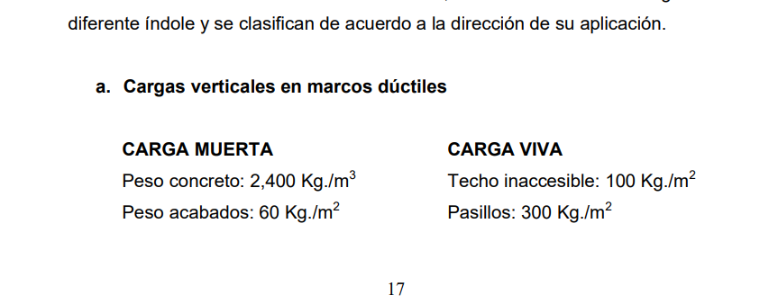

Slide 2
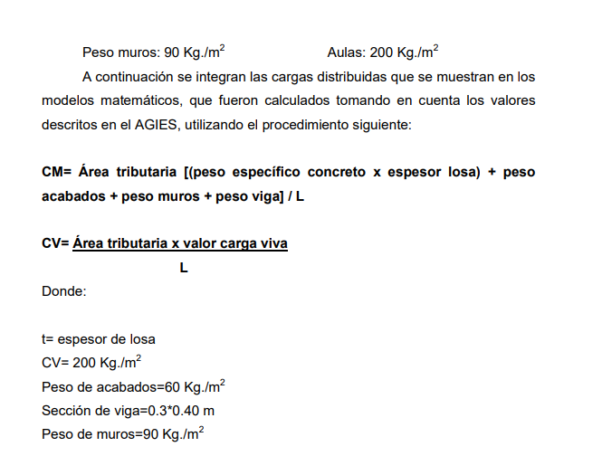

Slide 3
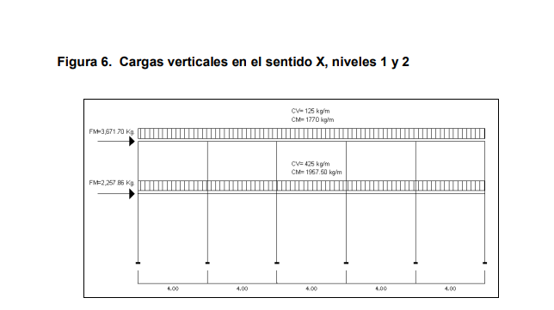

Slide 4
Lprom
2.5 + 3.0 + 5.0 + 2.5 + 5.0 + 4 0
• = 3.67kN/m2
6

Slide 5
20220919cimentaciones
https://www.youtube.com/watch?v=n_J0B0q1tIA
20220919cimentaciones
9SPT

